Slide 1


Linux Network
Jinqing Yan
12/12/2019
Notes:
Welcome to the talk 交流回忆下网络的相关技术. SBG本质上是一个基于LINUX网络的产品。。
Linux Netowrk是一个比较简单又以复杂的内容。简单是因为它做得很完美，功能很强大； 复杂也是因为它做做得太完美，功能很强大。
所以这是一个系列的TOPIC，包括了网络的基础，网络的实现以及网络的应用

Slide 2
Agenda
Network Basics
Linux Kernel Network
Generic Load Balancer
LWLB Load Balancer
ZLB Load Balancer for Cloud Native, LBaaS
Notes:
一起回忆， 交流，学习

Slide 3

BFD
macvlan ipvlan
Network Basics
namespace
route
Jinqing Yan
iptables
Notes:
网络的基础； 每天都接触网络，不陌生，只是简单地一起回忆。
下一页

Slide 4
Agenda
TCP/IP
Network Namespace
Interfaces
Bridge
iptables
IP Route
BFD/ERS
H248
Notes:
TCP/IP模型；
NS管理一个TCP/IP栈,实现隔离；
一个包从到INTERFACE开始，就决定了NS的归属，常用的INTERFACE，bridge如何工作的；
在网络层上的包过滤防火墙 以及 包的路由；
如何对路由连通性进行监控；
H248的有趣又高级的话题：流，拓朴，媒体协商 资源预留 和组 预留

Slide 5
TCP/IP
Network Namespace
L4 App
L3 Transport
L2 Internet
interface + driver
IP / ARP / ICMP / IGMP
TCP/UDP/SCTP
SIP / H248/BFD
L1 Network Interface
eth / VLAN / macvlan / ipvlan / veth / bridge/tun
IP/ICMP /ARP/Route/Netfilter/IPSEC
TCP/UDP/SCTP/TLS
SOCKET
SOCK_STREAM,
SOCK_DGRAM,
SOCK_RAW
SOCK_SEQPACKET
Notes:
谈到网络，OSI： 适用于理论研究，会话层和表示层。
TCP/IP的参考模型。TCP/IP： 更适用于工程 实践。更贴近于LINUX的理念 什么 理念？
将协议分成四个层次 网络接口层，网际互联；传输，应用层。从LINXU的角度看LAYER划分。
NAMESPACE。
SBG常用的interface; 经常会碰到的L2 名词； SBG L3 协议 ； 最后是SOCKET API
回车。

Slide 6
Network Namespace
Linux Network namespace partition the use of NW into different boxs, virtualizing the network within a single running kernel instance.
sbg_ADC-1:~ # ip link add link eth3 name eth3.1000 type vlan id 1000
sbg_ADC-1:~ # ip netns add ns_test
sbg_ADC-1:~ # ip netns list
ns_test
alb_1_alb_1_fee1
vr_0
sbg_ADC-1:~ # ip link set eth3.1000 netns ns_test
sbg_ADC-1:~ # ip netns exec ns_test bash
sbg_ADC-1:~ # ip link show eth3.1000
22: eth3.1000@if7: <BROADCAST,MULTICAST> mtu 1500 qdisc noop state DOWN mode DEFAULT group default qlen 1000
link/ether fa:16:3e:22:a9:a9 brd ff:ff:ff:ff:ff:ff link-netnsid 0
sbg_ADC-1:~ # ls /var/run/netns
alb_1_alb_1_fee1 vr_0
sbg_ADC-1:~ # ls /var/run/netns
alb_1_alb_1_fee1 ns_test vr_0
dev_net_set(dev, net);
https://blogs.igalia.com/dpino/2016/04/10/network-namespaces/
Notes:
1 SBG通过北向创 PCSCF等interface 网络， 包含 网络ＩＤ。 会创建出一个VR，VR 是什么 ？ 为什么要不同VR ？ ＶＬＡＮ，路由，ＩＰ，防火墙等隔离。
２ VR本质是网络命名空间，作用。
3 用例子说明 网络NS。
4 回车 网络 NS的本质是什么 ？ 创建文件； SET DEVICE。 LINUX里面 everything is file.
5 能否手动创一个NS 文件 ?

Slide 7
E.G how does “ip netns add ns_test” work ?
sbg_ADC-0:~ # touch /var/run/netns/ns_test
sbg_ADC-0:~ # ls -i /var/run/netns/ns_test
4026534803 /var/run/netns/ns_test
sbg_ADC-0:~ # unshare --net bash
sbg_ADC-0:~ # readlink /proc/self/ns/net
net:[4026534912]
sbg_ADC-0:~ # ls -i /var/run/netns/ns_test
4026534803 /var/run/netns/ns_test
sbg_ADC-0:~ # mount --bind /proc/$$/ns/net /var/run/netns/ns_test
sbg_ADC-0:~ # ls -i /var/run/netns/ns_test
4026534912 /var/run/netns/ns_test
sbg_ADC-1:~ # ip netns list
ns_test
alb_1_alb_1_fee1
vr_0
New File Under /var/run/netns
unshare current network namespace
Mount and bind net file /proc/self/ns/net with New ceated File
More NETNS Design please refer to ipnetns.c in iproute2 package
Notes:
1 创建文件，查看INODE value
2 unshare 将子进程与父进程网络空间不共享，会拷贝父进程虚拟文件系统， ls ns_test
挂载绑定到进程网络
SUM：ip netns add: 创建一个var run net文件，unshare网络命名空间，挂载绑定网络命名空间文件。
在NS里面执行进程： 打开文件， unshare网络命名空间，挂载绑定网络命名空间文件

Slide 8
Linux Interface
eth / VLAN / macvlan / ipvlan / veth / bridge/tunnel (IPIP / GRE / IPSEC / Vxlan)
Overlay Network
PL
NS1
br0
FEE
LBE
SGC
ERS
eth1.116
veth.116
tun
tun
tun
tun
eth1.116
macvlan
macvlan
macvlan
veth
evipdev
llb interface
eth1
eth0
ip help
? IPVLAN
MTU?
Notes:
1 常用的interface, 用一个例子来介绍，例子框图，介绍interface名称
3 个namespace,
NS1,FEE用bridge通信； fee/lbe用macvlan.
2 介绍eth, vlan, veth, tunnel, macvlan,
3 介绍其它tunnel, IPIP GRE,IPSEC,VXLAN
4介绍 IPVLAN
5 开放性问题MTU，进来的包和出去的包受哪些interface MTU影响 ？

Slide 9
Bridge Router(eth0.2001) -> eth1 -> cni0 (br) -> vetheffec9e3 (veth)-> eth3 ( veth ) -> eth3.2001
host
cni0
POD
eth3.2001
eth0.2001
0a:58:0a:03:12:41
10.21.2.11
0a58.0a03.0645
10.21.2.2
eth1
vetheffec9e3
eth3
8c:dc:d4:1c:a0:98
8a:47:b3:bc:f1:9a
0a:58:0a:03:12:41
ers-router-65656b9c6-jmh87>show arp
IP Address MAC Address Interface State
10.10.121.7 8c:dc:d4:1c:9c:a8 eth1.2002 STALE
10.21.2.11 0a:58:0a:03:12:41 eth0.2001 STALE
10.21.2.12 0a:58:0a:03:12:26 eth0.2001 STALE
10.21.2.20 0a:58:0a:03:12:26 eth0.2001 STALE
bay4:~ # brctl show cni0
bridge name bridge id STP enabled interfaces
cni0 8000.0a580a030001 no eth1
vetheffec9e3
Notes:
0 介绍bridge 转换FDB表， CLOUD K8S环境上通用，
1 回车 一台HOST, 一个POD 网络NS， 一台ROUTER，IP介绍
2 进来和出去的包如何二层转发
3 开放性问题 MAC地址会不会变 ?

Slide 10
bay4:~ # bridge fdb show cni0
0a:58:0a:03:12:41 dev vetheffec9e3 master cni0 //eth3; eth3.2001
8a:47:b3:bc:f1:9a dev vetheffec9e3 vlan 1 master cni0 permanent
8a:47:b3:bc:f1:9a dev vetheffec9e3 master cni0 permanent
33:33:00:00:00:01 dev vetheffec9e3 self permanent
33:33:00:00:00:02 dev vetheffec9e3 self permanent
01:00:5e:00:00:01 dev vetheffec9e3 self permanent
33:33:ff:bc:f1:9a dev vetheffec9e3 self permanent
33:33:ff:00:00:00 dev vetheffec9e3 self permanent
fa:16:3e:71:13:5d dev eth1 master cni0
8c:dc:d4:1c:a0:98 dev eth1 master cni0 permanent // eth1.
fa:16:3e:96:ba:f8 dev eth1 master cni0
00:e0:2b:00:00:01 dev eth1 master cni0
8c:dc:d4:1c:a0:98 dev eth1 vlan 1 master cni0 permanent
fa:16:3e:6c:a6:90 dev eth1 master cni0
fa:16:3e:c9:d3:a1 dev eth1 master cni0
fa:16:3e:a1:16:75 dev eth1 master cni0
fa:16:3e:21:b0:98 dev eth1 master cni0
fa:16:3e:a1:b2:96 dev eth1 master cni0
02:04:96:52:c0:de dev eth1 master cni0
0a:58:0a:03:06:45 dev eth1 master cni0 //ERS.
Forward Route Rule:
Destination Out-Port

Slide 11
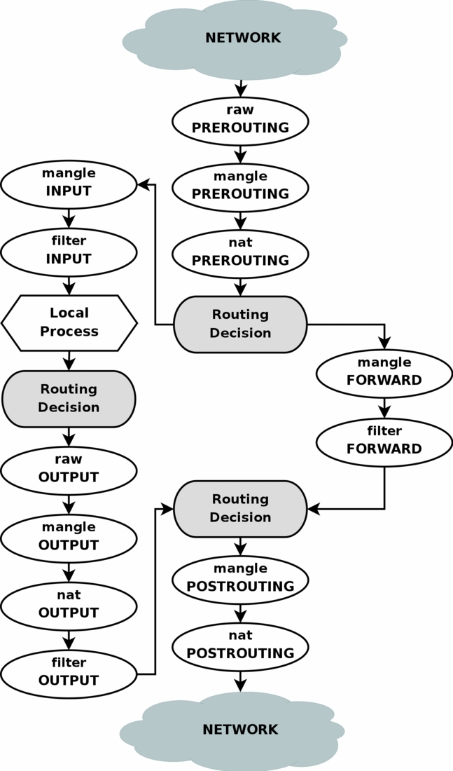
L2 - netfilter / iptables
There are 4 default tables defined:
> raw table: NOTRACK or packet counter
> mangle table: TOS, TTL,MARK
> nat table: NAT
> filter table: filtering packets
Commands:
iptable -t TABLE ….
e.g iptables -t mangle -nvL
Notes:
L2 network layer, including ICMP, IP , packet filter.
Kernel define a Netfilter to support packet filter. HOOKs From ip rcv to local deliver or forward.
Time: IN: PREROUTING, INPUT/forward; OUT: OUTPUT, POSTROUTING
根据功能：define 4 tables. RAW, MANGLE, NAT, FILTER
命令演示 fe notrack; BF mangle, ip rule 1024; ip route 1024; ip -6 tun show; ip -d link show adc_ipvlan0

Slide 12
iptables - conntrack
Information of a connection , containing the source and destination IP addresses, port number pairs, protocol types, state.
support TCP, UDP, ICMP and SCTP by separated kernel modules.
Each connection has two tuples, Original Tuple and Reply Tuple; each tuple is generated based on src_ip, dest_ip, src_port, dest_ip and L4 protocol.
raw
PREROUTING
CONNTRACK
mangle
PREROUTING
raw
OUTPUT
CONNTRACK
mangle
OUTPUT
Notes:
1 what is conntrack;
Purpose ? Tcp non-syn attack; stickiness….
A complete packet; need defrag packets.

Slide 13
iptables - conntrack
sbg_ADC-1:~ # conntrack -E -p sctp
[NEW] sctp 132 3 COOKIE_WAIT src=10.21.0.4 dst=10.10.121.18 sport=5060 dport=5060 [UNREPLIED] src=10.10.121.18 dst=10.21.0.4 sport=5060 dport=5060 mark=101001
[UPDATE] sctp 132 3 COOKIE_WAIT src=10.21.0.4 dst=10.10.121.18 sport=5060 dport=5060 [UNREPLIED] src=10.10.121.18 dst=10.21.0.4 sport=5060 dport=5060 mark=101001
[UPDATE] sctp 132 2 COOKIE_WAIT src=10.21.0.4 dst=10.10.121.18 sport=5060 dport=5060 src=10.10.121.18 dst=10.21.0.4 sport=5060 dport=5060 mark=101001
[UPDATE] sctp 132 2 COOKIE_ECHOED src=10.21.0.4 dst=10.10.121.18 sport=5060 dport=5060 src=10.10.121.18 dst=10.21.0.4 sport=5060 dport=5060 mark=101001
[UPDATE] sctp 132 432199 ESTABLISHED src=10.21.0.4 dst=10.10.121.18 sport=5060 dport=5060 src=10.10.121.18 dst=10.21.0.4 sport=5060 dport=5060 [ASSURED] mark=101001

Slide 14
IP Route/Rule
Static Route
fe-10:~ # ip netns exec alb_1_fee_alb1_0 ip route show
default via 10.21.2.2 dev eth3.2001
10.21.2.0/24 dev eth3.2001 proto kernel scope link src 10.21.2.11
Rule Route
fe-10:~ # ip netns exec alb_1_fee_alb1_0 ip rule show
3: from 10.21.0.4 lookup main
4: from all fwmark 0x400 lookup 1024
4: from all fwmark 0x401 lookup 1025
10: from all lookup local
32766: from all lookup main
32767: from all lookup default
fe-10:~ # ip netns exec alb_1_fee_alb1_0 ip route show table 1024
default dev z_tun_1005 scope link
How to add route entries in code practice ?
iproute2 package
Notes:
What is route ? To Where though which interface.
Static / rule
What is purpose of rule route ?
Open 如何在代码中创建路由？

Slide 15
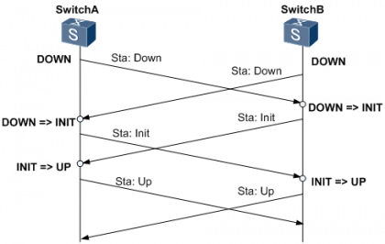
BFD/ERS
ERS can offer ECMP, BFD, OSPF, BGP and so on functions. SBG introduces ERS for BFD and OSPF purpose.
bash-4.3# imish
ZebOS version 7.9.0 IPIRouter 04/03/17 10:42:36
ers-router-65656b9c6-jmh87>enable
ers-router-65656b9c6-jmh87#show running-config
interface eth0.2000
ip address 10.10.230.1/28
ipv6 address fe80::1120/64
ipv6 address 3001:10:230::1/64
no shutdown
bandwidth 10g
ip static bfd
ipv6 static bfd
bfd interval 400 minrx 400 multiplier 4
!
ers-router-65656b9c6-jmh87#configure terminal
Enter configuration commands, one per line. End with CNTL/Z.
ers-router-65656b9c6-jmh87(config)#interface eth0.2001
ers-router-65656b9c6-jmh87(config-if)#ip static bfd disable
ers-router-65656b9c6-jmh87(config-if)#ip static bfd disable
6.8.5. Detecting Failures with the Echo Function
Xiaobing.Liang@ericsson.com; jim.ji@ericsson.com
Notes:
1 ERS是什么 ？ 在SBG中的使用
2 目前LDA主要用BFD功能，做路由连通性检查； 并动态增加删除路由。
基本的状态机
配置介绍
个人开发联系人（非官方）。

Slide 16
H248

Slide 17
Summary
TCP/IP Layers
What is Linux namespace
Different type of Linux interfaces used by SBG
How does iptables work
Basic IP route
BFD and ERS basics.
H248

Slide 18

Linux Kernel Network
Jinqing Yan
Only share what I know ; Only share common network handler

Slide 19
Agenda
General
Driver Basics
Network Namespace
Netfilter
CT for SCTP
Some Kernel Issues
Build and Patch

Slide 20
General
Sock
TCP/IP
Netfilter
eBPF
SKB
Upper Interfaces
driver
NIC

Slide 21
Driver Basics
A modern NIC device is always appended to the PCI device list
Kernel describes a NIC with struct pci_dev and struct net_device.
Kernel uses pci_driver and net_device_ops to drive and operate a net device
The driver may be based on Linux NAPI or none NAPI
static struct pci_driver ixgb_driver = {
.id_table = ixgb_pci_tbl,
.probe = ixgb_probe,
};
struct net_device_ops ixgb_netdev_ops = {
.ndo_open = ixgb_open,
.ndo_stop = ixgb_close,
.ndo_start_xmit = ixgb_xmit_frame,
};
Notes:
1、网卡在同一时刻只能接收一个包，当网卡接收到包之后，马上向中断控制器发出中断请求，中断控制器向CPU发出中断信号。
2、网卡在同一时刻能接收多个包，单CPU，网卡接收到多个包的时刻，马上向中断控制器发出中断请求，中断控制器向CPU发出中断信号。
3、网卡在同一时刻能接收多个包，多CPU，网卡接收到多个包的时刻，马上向中断控制器发出中断请求，中断控制器向CPU发出中断信号，所有CPU都将接收到数据包放入同一个接受队列里。
4、网卡支持多队列+DMA方式，多CPU，网卡接收到多个包的时刻，主动把数据包通过网卡DMA到rx_ring（多个）里，当DMA完成时，发生网卡硬件中断，在硬中断里调用软中断，软中断把该CPU对应的r_ring里buffer拷贝到链路层（又称为接口层）接收队列里。

Slide 22
ixgb_init_module
Ifconfig ethx up
pci_register_driver
ixgb_driver
.ndo_open/ixgb_open
net_dev_init module
probe
Rx/Tx DMA allocation
register ixgb_netdev_ops
open_softirq(NET_TX_SOFTIRQ, net_tx_action)
Register HW interruptor handler
ixgb_intr
hw int
sw int
net_device
Register poll ixgb_clean
open_softirq(NET_RX_SOFTIRQ, net_rx_action)
netif_receive_skb
napi enable;
irq enable
netif_wake_queue
add device to net device list
skb
xmit_one
Tx que

Slide 23
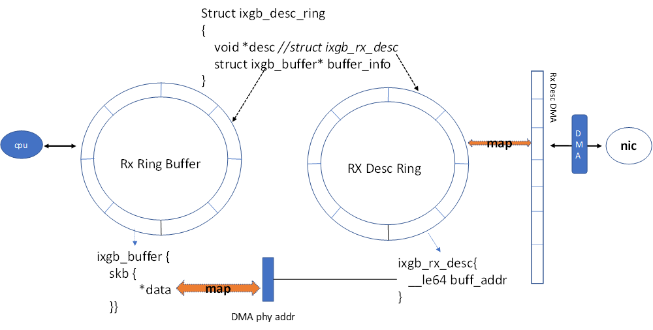

Slide 24
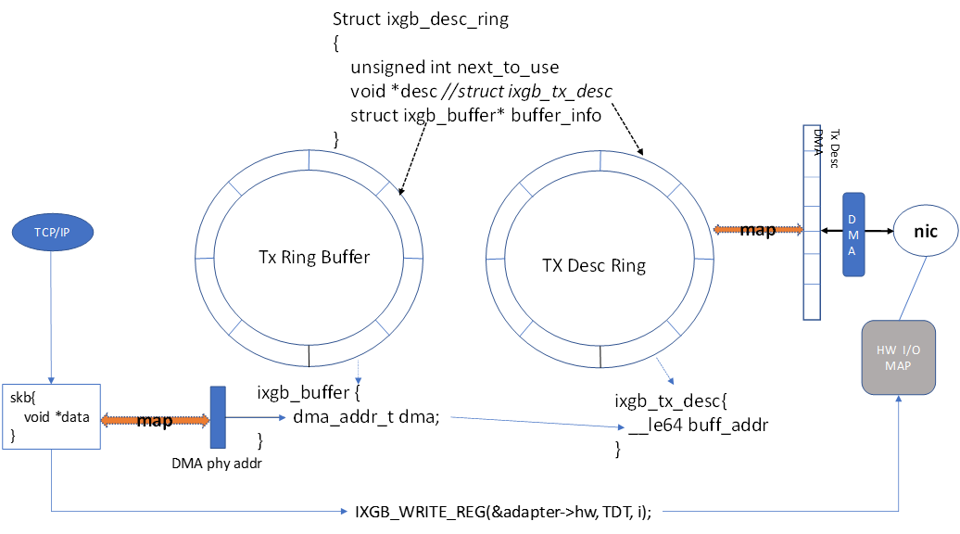

Slide 25
Network Namespace
ip netns add xxx / clone(CLONE_NEWNET) / unshare(CLONE_NEWNET)
Sock
open namespace file /var/run/netns/xxx
TCP/IP
Netfilter
BPF
copy_namespaces
unshare_nsproxy_namespaces
Upper Interfaces
nsproxy
struct net {
struct proc_dir_entry *proc_net;
struct ns_common ns {
const struct proc_ns_operations *ops;
unsigned int inum;
}
struct ctl_table_set sysctls;
}
driver
NIC
struct net *net
net_namespace

Slide 26
Network Namespace
Ip netns exec xxx bash
P1 open /var/run/netns/xxx
Sock
TCP/IP
Netfilter
BPF
Setns(CLONE_NEWNET)
SKB
Upper Interfaces
get_proc_ns(file_inode(file))
copy_mnt_ns;
nsproxy
driver
struct nsproxy *ns
struct task_struct {
struct nsproxy*nsproxy {
struct net *net_ns;
}
}
NIC
switch_task_namespaces

Slide 27
Network Namespace
Sock
ip link set eth0 netns ns_test
TCP/IP
open namespace file
Netfilter
BPF
SKB
rtnl
Upper Interfaces
struct net *net
driver
Struct dev {
possible_net_t nd_net {
struct net *net;
}
}
dev_net_set(dev, net)
NIC

Slide 28
Linux Netfilter

Slide 29
Conntrack for SCTP Netfilter
CONNTRACK
sctp
raw
PREROUTING
mangle
PREROUTING
nf_conntrack_in
sctp_new/sctp_packet
CONNTRACK
sctp
raw
OUTPUT
mangle
OUTPUT

Slide 30
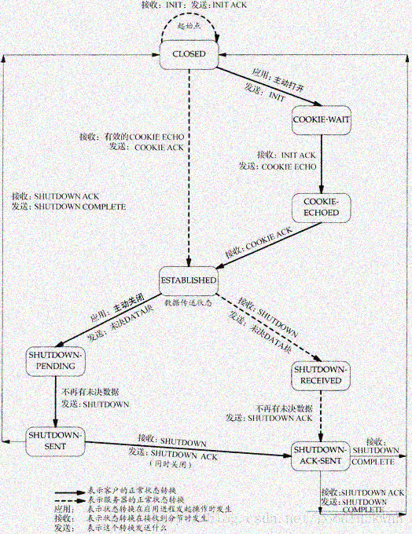
Conntrack for SCTP
Conntrack sctp maintains a state machine
static const u8 sctp_conntracks[2][11][SCTP_CONNTRACK_MAX]
An event is reported in sctp_packet when state switched
sctp_new/nf_conntrack_sctp_packet handles with a new sctp connection. The state is set in both while sctp_packet tries to report event out.
We never has a chance to get the sctp state of INIT and INIT ack packet [CC-23057]

Slide 31
Conntrack for SCTP
host server
10.10.121.7
SBG sends out INIT msg
PN can’t get the new sctp connection event.
When FE receives the INIT ACK, it can’t restore an connection from kernel.
10.10.121.2
router
10.21.2.2
INIT
INIT ack
10.21.2.11
FE namespace
10.21.2.12
FE namespace
CT
CT
INIT
sctp socket
Vip:10.21.0.4
INIT ack
CT

Slide 32
Conntrack for SCTP
host server
10.10.121.7
PN receives a CT connection entry of SCTP INIT and SCTP state switches to COOKIE_WAITING.
PN replicate this connection to all FEs, the reply verification TAG is initiate tag of INIT packet.
SBG SCTP replies INIT ACK, but PN can’t get new event from kernel, but the SCTP state is still COOKIE_WAITING. So the original verification Tag is 0, which can mismatch with incoming SCTP COOKIE ECHO packet.
FE receives the COOKIE ECHO packet. The verification TAG in this packet can’t match with the expected original verification tag.
10.10.121.2
router
10.21.2.2
INIT
INIT ack
Cookie Echo
10.21.2.11
FE namespace
10.21.2.12
FE namespace
CT
CT
INIT
sctp socket
Vip:10.21.0.4
INIT ack
CT

Slide 33
Some Kernel Issues

Slide 34
Build and Patch
Download https://arm.rnd.ki.sw.ericsson.se/artifactory/proj-cba-all/com/ericsson/cba/lde/lde-reference_os/1.7.0-9/lde-reference_os-1.7.0-9-api-sle12.tar.gz
2 mkdir build
3 Copy lde-reference_os-1.7.0-9-api-sle12.tar.gz to build
4 cd to build and “tar xf lde-reference_os-1.7.0-9-api-sle12.tar.gz ”
5 After tar successfully, cd to usr/src/linux
6 Apply the patches here
7 After patching ok, do “cp . ../ linux-4.4.121-92.117.1.17948.2.PTF.1140012-obj /x86_64/default/.config . “
8 make oldconfig && make

Slide 35
Summary
Driver Basics
Network Namespace
Netfilter
CT for SCTP
Some Kernel Issues
Build and Patch

Slide 36
Generic Load
Balancer and eVIP
Jinqing Yan

Slide 37
Agenda
Generic Load Balancer Archetypes
Technical Focus Points
EVIP Description
EVIP Traffic Handler

Slide 38
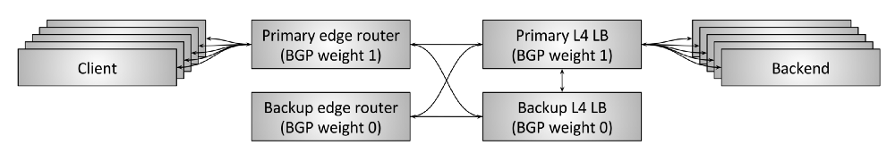
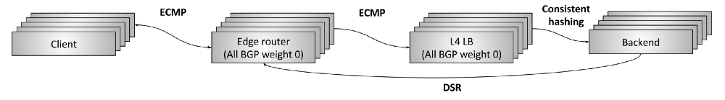
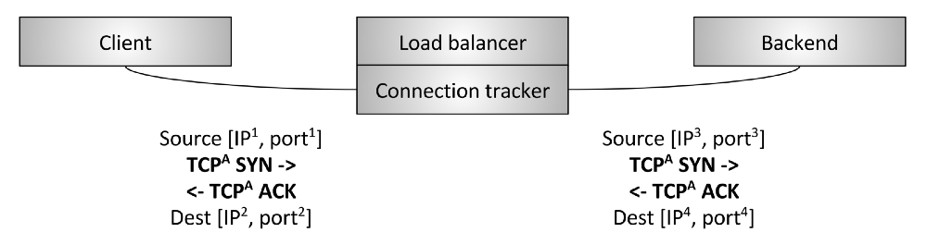
Generic Load Balancer Archetypes

Slide 39
Generic Load Balancer Archetypes
ECMP
client
edge router
all weight 0
L4 LB
backend
Tunnel

Slide 40
Technical Focus Points
O&M
Configurations, Monitoring and Debugging
Service Discovery
Cluster based, TIPC, API or TCP
Fast packet processing
Kernel Space Processor;
User Space Processor
Backend Load Balance
Fragment Handling Support
Connection Stickiness
Expose VIP outside
OSPF, BGP ; BFD plus
LB
Front End
Forwarder
Frag handler
Consistent Hash
Connection track
VIP Announcer
Backend Pool
Service Discover
O&M

Slide 41
eVIP SW Arch.
LB
EVIPC
FE
LBE
PN
PN Pool
ERS
LBE pool
Connection track
vip
Frag handler
Consistent Hash
LVS
Consistent Hash
Whiteboard

Slide 42
Service Discovery
fe
agent connect
evipc
repdb
lbe
active evipc
evipc
pn
ersip
service_available
Z
subnodedb
create_subnode
factory
libdtm
factory
factory.n
create_remote subnode
Subnode data
Y
Subnode data
Y
Subnode data
wb
wb
wb
service announce
TIPC
Protocol Y
Protocol Z
TIPC socket
Protcol X
https://openalm.lmera.ericsson.se/plugins/mediawiki/wiki/evip/index.php?title=Whiteboard
Create FE service

Slide 43
Traffic Handling

Slide 44

LWLB
Jinqing Yan

Slide 45
General
Supply VIP function
Support TCP Traffics Distribution.
Support SCTP Single-homing and Multi-homing traffics Distribution
Support UDP Traffics Distirbution.
Support few connections, like no more than 100 connections
hash
CT
ct xmitter
ct receiver

Slide 46
LWLB Arch.
LB
API
FE
PN
ERS
PN pool
vip
Frag handler
Connection Hash
Connection track
Hash
Whiteboard
hash
CT
ct xmitter
ct receiver

Slide 47
Service Discovery
erlang
erlang
add fe
adc controller
API
adc controller
API
Z
PN Controller
Z
PN Controller
FE Controller
FE Controller
whiteboard
whiteboard
TIPC
Protocol z
add fe service
hash
CT
ct xmitter
ct receiver

Slide 48
iptables and hash rule – TCP/UDP
-A PREROUTING -d 10.21.0.4/32 -p tcp -j LWLB_CONNTRACK_FORWARDING
-A PREROUTING -m mark --mark 0x0 -g LLB1_sel
-A LLB1_sel -d 10.21.0.4/32 -g LLB1_dVIP
-A LLB1_dVIP ! -p esp -j HMARK --hmark-src-prefix 32 --hmark-dst-prefix 32 --hmark-sport-mask 0xffff --hmark-dport-mask 0xffff --hmark-rnd 0xc175a3b8 --hmark-mod 32 --hmark-offset 2048 -A LLB1_dVIP -p esp -j HMARK --hmark-src-prefix 32 --hmark-dst-prefix 32 --hmark-rnd 0xc175a3b8 --hmark-mod 32 --hmark-offset 2048
-A LLB1_dVIP -m mark --mark 0x0 -j DROP
-A LLB1_dVIP -j RETUR
-A LWLB_CONNTRACK_FORWARDING -p tcp -m conntrack --ctstate NEW -m tcp ! --tcp-flags FIN,SYN,RST,ACK SYN -j DROP
-A LWLB_CONNTRACK_FORWARDING -p tcp -m tcp ! --tcp-flags FIN,SYN,RST,ACK SYN -j CONNMARK --restore-mark --nfmask 0xffffffff --ctmask 0xffffffff
-A LWLB_CONNTRACK_FORWARDING -p tcp -m tcp ! --tcp-flags FIN,SYN,RST,ACK SYN -m mark --mark 0x0 -j DROP

Slide 49
TCP Connection Replication
Only replicate connection for TCP
Assure that TCP packets are processed on same PN.
Assure that TCP packets can be handled by any FE to endure ECMP bugs on router

Slide 50
Connection Replication
Passive Connection
FEE
PN
FEE
PN
FEE
PN
VIP
incoming traffics
outgoing traffics
tcp connection replication
Kernel inject
hash
CT
ct xmitter
ct receiver

Slide 51
Connection Replication
Active Connection
FEE
PN
FEE
PN
FEE
PN
VIP
incoming traffics
outgoing traffics
tcp connection replication
Kernel inject
hash
CT
ct xmitter
ct receiver

Slide 52
Connection Replication
tcp syn
tcp syn ack
router
tcp syn
tcp syn ack
fe1
fe2
fe x
fe n
tcp syn
tcp syn ack
PN
outgoing traffics
incoming traffics
tcp connection replication
ct xmitter
ct receiver

Slide 53
LWLB for SCTP
To support VIP function and Load Balance for SCTP connections, including single-homing and multi-homing cases.
In the case of multi-homing, More Local IP addresses are included in INIT msg and also INIT ACK message. Those IP addresses can build up several different Paths in one SCTP association.
When acting as client, ADC Nodes should different port.
To support Path Switchover, SCTP follows TCP to do connection replication for all paths.
SCTP Peer
SCTP Peer

Slide 54
SCTP Rules
iptables -t mangle -N SCTP_CONNTRACK_FORWARDING
iptables -t mangle -I PREROUTING -p sctp -d 10.21.0.4/32 -j SCTP_CONNTRACK_FORWARDING
// drop invalid SCTP packet if ct status is NEW while chunk type is not INIT
iptables -t mangle -A SCTP_CONNTRACK_FORWARDING -p sctp -m sctp --chunk-types any INIT -j RETURN
//restore the connection mark for this SCTP packet.
iptables -t mangle -A SCTP_CONNTRACK_FORWARDING -p sctp -m sctp ! --chunk-types any INIT -j CONNMARK --restore-mark --nfmask 0xffffffff --ctmask 0xffffffff
//drop the packet if mark is 0.
iptables -t mangle -A SCTP_CONNTRACK_FORWARDING -p sctp -m mark --mark 0x0 -j DROP

Slide 55
Connection Replication
host server
10.10.122.8
host server
10.10.121.7
10.10.122.2
10.10.121.2
router
router
10.22.2.2
10.21.2.2
data
ACK
INIT
INIT ack
10.22.2.11
FE namespace
10.22.2.12
FE namespace
10.21.2.11
FE namespace
10.21.2.12
FE namespace
CT
CT
DATA
INIT
sctp socket
Vip:10.22.0.4
ACK
sctp socket
Vip:10.21.0.4
INIT ack
Local: [10.21.0.4, 10.22.0.4], Remote [10.10.121.7, 10.10.122.8]
KERNEL BUG CC-23057

Slide 56
Connection Replication
host server
10.10.121.7
10.10.122.8
host server
10.10.121.7
10.10.122.8
10.10.121.2 10.10.122.2
10.10.121.2 10.10.122.2
router
router
10.21.2.2 10.22.2.2
10.21.2.2 10.22.2.2
INIT
INIT ACK
INIT
INIT ACK
10.21.2.11
FE namespace
10.22.2.12
FE namespace
10.22.2.11
FE namespace
10.21.2.12
FE namespace
CT
CT
INIT
INIT
Vip:10.21.0.4
Vip:10.22.0.4
INIT ACK
INIT ACK
Vip:10.22.0.4
Vip:10.21.0.4

Slide 57
IP Stacking

Slide 58

ZLB for Cloud Native
Jinqing Yan

Slide 59

ZLB Arch.
LB
O&M API
FE
BF
PN
PN Pool
ERS
BF pool
vip
Connection Track
Frag handler
Consistent Hash
Connection Hash
Consistent Hash
Whiteboard
GoLB

Slide 60
General
Supply VIP function
Support TCP Traffics Distribution
Support ESP Traffics Distribution
Support SCTP Single-homing and Multi-homing traffics Distribution
Support UDP Traffics Distribution
Support BGP
K8S Pod Service Discovery.
LB Service Discovery
https://gerrit.ericsson.se/#/c/5802199/

Slide 61
Service Discovery
K8S O&M Service
alb config
adc controller
API
adc controller
API
adc controller
API
FE Controller
BF Controller
PN Controller
whiteboard
whiteboard
whiteboard
GoLB
GoLB
GoLB
K8S cluster
K8S API Server
Pod Service Discovery
Internal call
Protocol Z
Alb Service Discovery

Slide 62
iptables rules
FE
RAW: -A PREROUTING -j NOTRACK
Mangle: -A LLB1 -j HMARK --hmark-src-prefix 32 --hmark-dst-prefix 32 --hmark-sport-mask 0xffff --hmark-dport-mask 0xffff --hmark-rnd 0xc175a3b8 --hmark-mod 32 --hmark-offset 1024
-A LLB1 -m mark --mark 0x0 -j DROP
BF
-A PREROUTING -s 10.21.0.4/32 -j FE_HMARK_FORWARDING
-A FE_HMARK_FORWARDING -j HMARK --hmark-src-prefix 32 --hmark-dst-prefix 32 --hmark-sport-mask 0xffff --hmark-dport-mask 0xffff --hmark-rnd 0xc175a3b8 --hmark-mod 32 --hmark-offset 2048

Slide 63
BF
-A PREROUTING -d 10.21.0.4/32 -p tcp -j ADC_CONNTRACK_FORWARDING
-A LLB1_dVIP ! -p esp -j HMARK --hmark-src-prefix 32 --hmark-dst-prefix 32 --hmark-sport-mask 0xffff --hmark-dport-mask 0xffff --hmark-rnd 0xc175a3b8 --hmark-mod 32 --hmark-offset 2048 -A LLB1_dVIP -p esp -j HMARK --hmark-src-prefix 32 --hmark-dst-prefix 32 --hmark-rnd 0xc175a3b8 --hmark-mod 32 --hmark-offset 2048
-A LLB1_dVIP -m mark --mark 0x0 -j DROP
-A ADC_CONNTRACK_FORWARDING -p tcp -m conntrack --ctstate NEW -m tcp ! --tcp-flags FIN,SYN,RST,ACK SYN -j DROP
-A ADC_CONNTRACK_FORWARDING -p tcp -m tcp ! --tcp-flags FIN,SYN,RST,ACK SYN -j CONNMARK --restore-mark --nfmask 0xffffffff --ctmask 0xffffffff
-A ADC_CONNTRACK_FORWARDING -p tcp -m tcp ! --tcp-flags FIN,SYN,RST,ACK SYN -m mark --mark 0x0 -j DROP
PN
-A LLB1 -j HMARK --hmark-src-prefix 32 --hmark-dst-prefix 32 --hmark-sport-mask 0xffff --hmark-dport-mask 0xffff --hmark-rnd 0xc175a3b8 --hmark-mod 32 --hmark-offset 20480

Slide 64
Connection Replication
Assure that TCP/SCTP packets are processed on same PN.
Assure that TCP/SCTP/UDP packets can be handled by any FE to endure ECMP bugs on router
Only replicate connection for TCP and SCTP
Replicate SCTP connection in real time
Replicate TCP connections during failover of BF Service

Slide 65
Connection Replication
FEE
BF
PN
FEE
BF
PN
FEE
BF
PN
VIP
incoming traffics
outgoing traffics
sctp connection replication
Kernel inject
hash
CT
ct receiver
tcp ct xmitter
sctp ct xmitter

Slide 66
BGP Support
ERS Refer to http://calstore.internal.ericsson.com/elex?LI=EN/LZN9014837/1R6CR
Or
others

